Slide 1
Decision Tree
Powerful supervised algorithm for both classification and regression
Represent rules in the form of a tree structure which can be understood by humans.

Slide 2
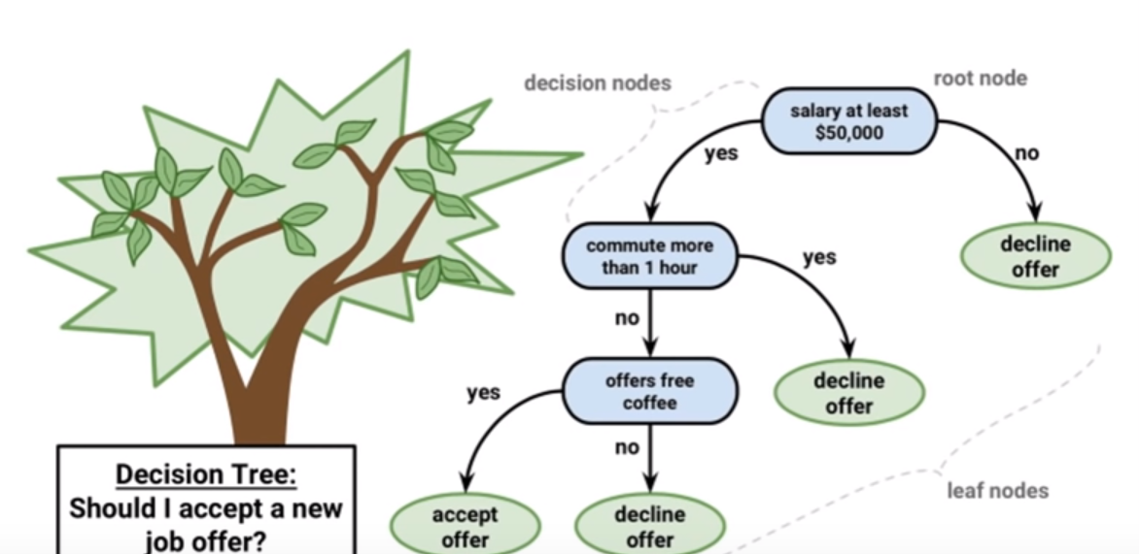
Graphical Representation

Slide 3
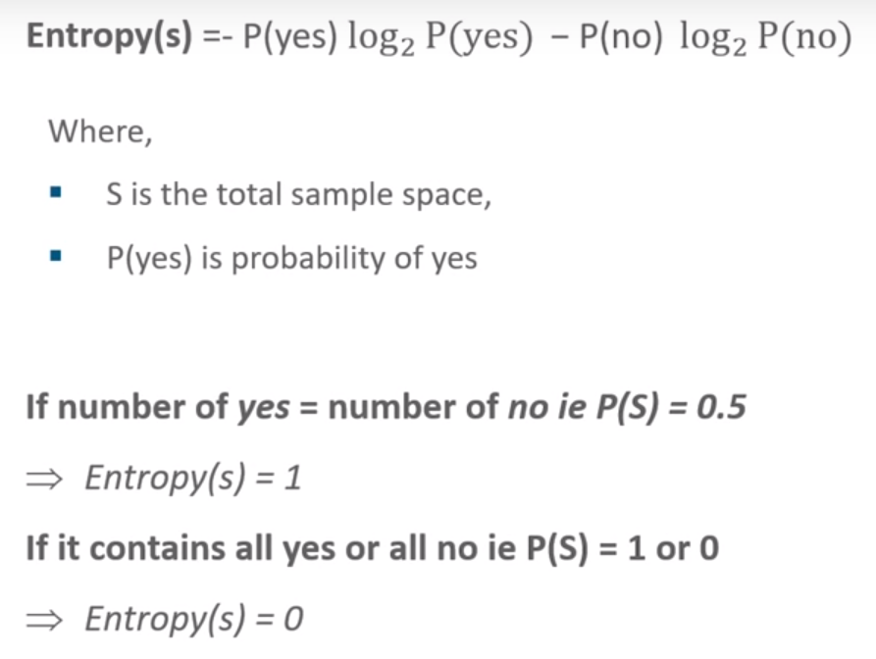
Entropy
Defines randomness(impurity) in data
First step to solve the problem of decision tree

Slide 4
Information Gain
Measures the reduction in entropy
Decides which attribute should be selected as the decision node
If S is our total collection, then
Information Gain = Entropy(S) - [(Weighted Avg) * Entropy(each feature)]

Slide 5
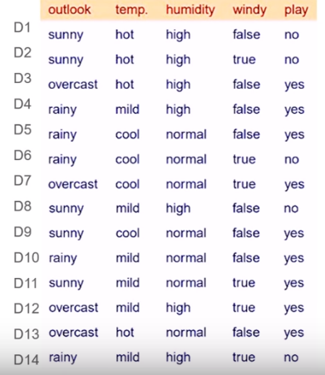
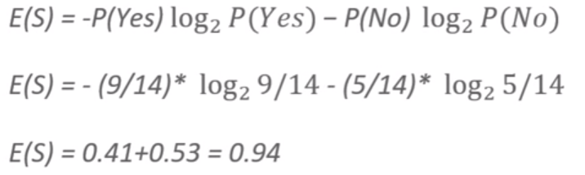
Training data
Computing Entropy for this data

Slide 6
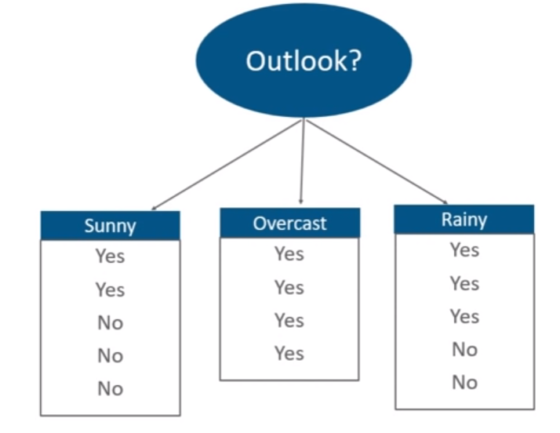
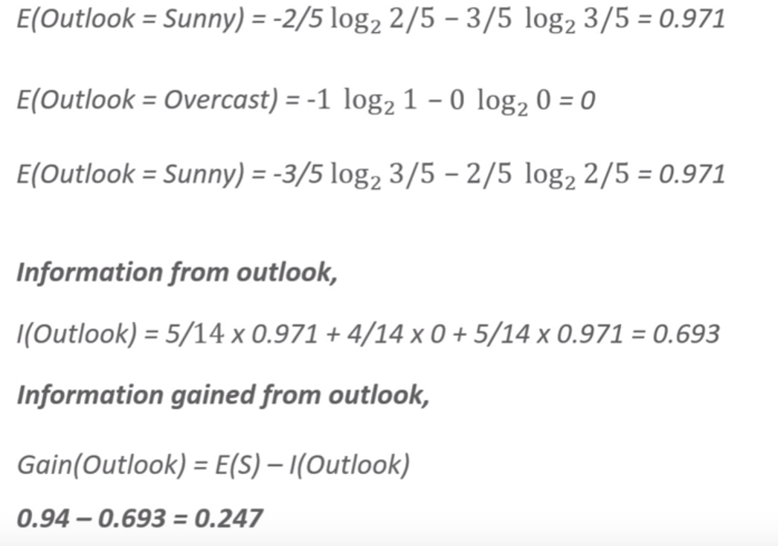
Information Gain for outlook

Slide 7
Information Gain from other attributes
Outlook : 0.247
Temperature : 0.029
Humidity : 0152
Windy : 0.048

Slide 8
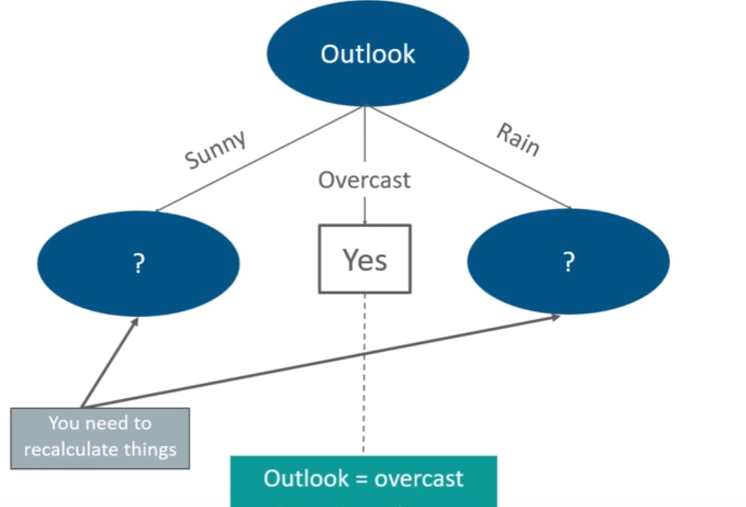
Now our decision tree will build like this

Slide 9
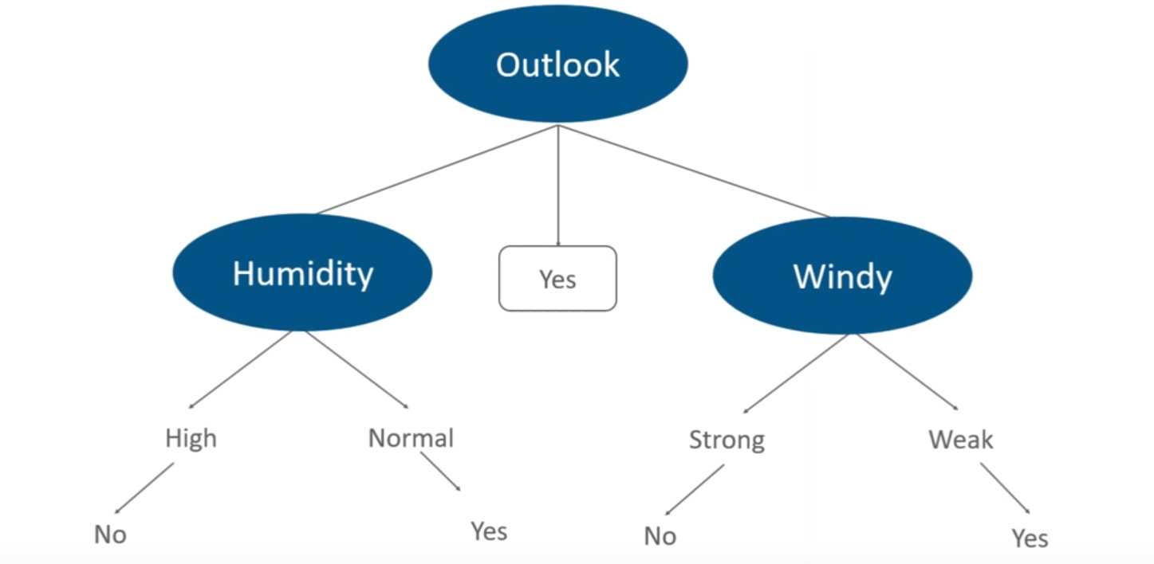
Finally, our decision tree will look like

Slide 10
Demo

Slide 11
K-Nearest Neighbors
KNN is a supervised machine learning algorithm that excels at classification and regression tasks.
The KNN algorithm works based on the idea that similar things are closer to each other.
choose an odd value of k if the number of classes is even, apply the elbow method to select the value of and use Cross Validation technique
Lazy learning

Slide 12
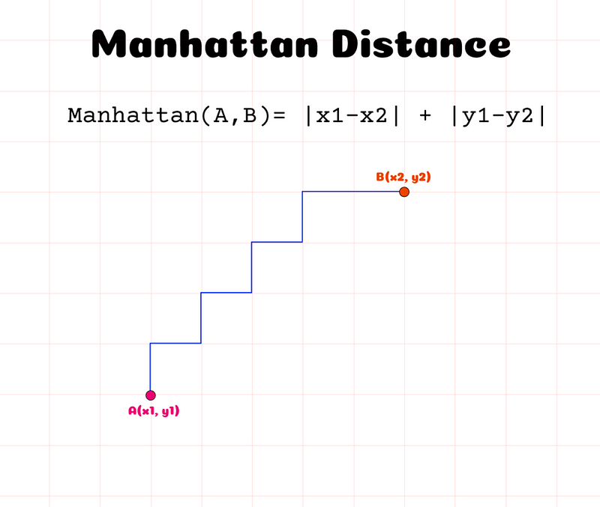
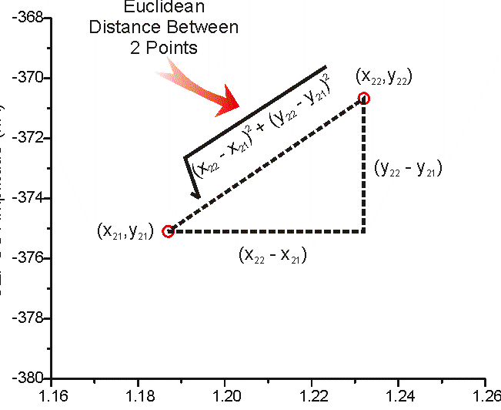

Slide 13
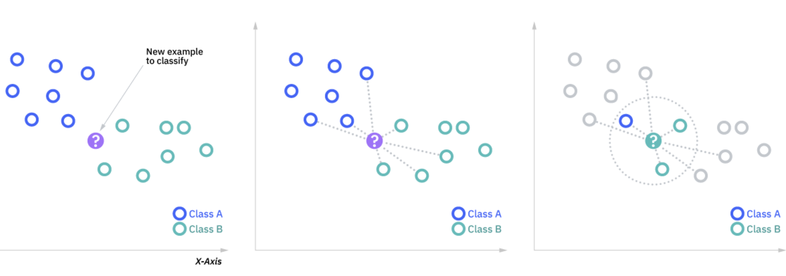
How KNN works

Slide 14
Demo

Slide 15
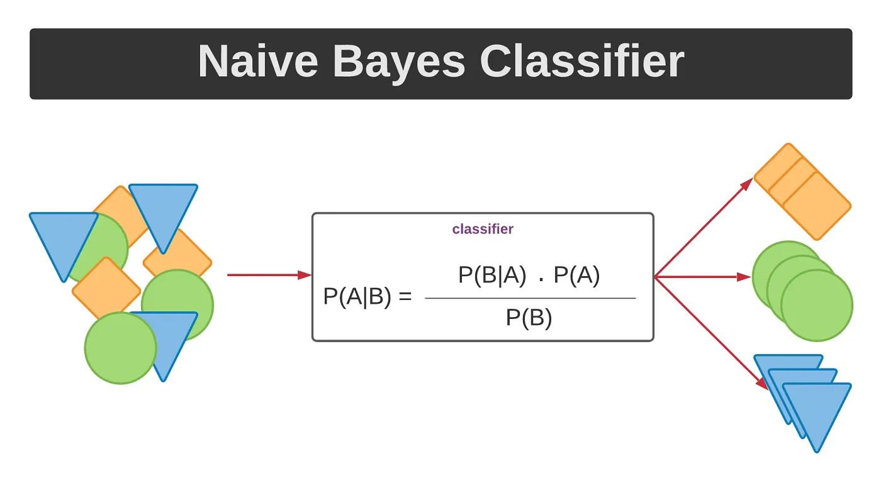
Naïve Bayes Classifier
Naive Bayes is a probabilistic classifier based on Bayes' Theorem.
Works well with high-dimensional data.
P(A∣B) is the posterior probability of class A given predictor B.
P(B∣A) is the likelihood of predictor B given class A.
P(A) is the prior probability of class A.
P(B)is the prior probability of predictor B.

Slide 16
Types of Naïve Bayes Classifier
Gaussian Naive Bayes: Assumes that the features follow a normal distribution.(Here we calculate the probability density)
Multinomial Naive Bayes: Used for discrete data like word counts in text classification.
Bernoulli Naive Bayes: Used for binary/Boolean features.

Slide 17
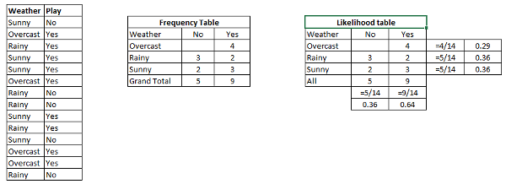
How do Naïve bayes Algorithm works?
Frequency Table
Likelihood Table
Use Naive Bayesian equation to calculate the posterior probability for each class.
The class with the highest posterior probability is the outcome of the prediction.
P(Yes | Sunny) = P( Sunny | Yes) * P(Yes) / P (Sunny)
P (Sunny |Yes) = 3/9 = 0.33
P(Sunny) = 5/14 = 0.36
P( Yes)= 9/14 = 0.64
P (Yes | Sunny) = 0.33 * 0.64 / 0.36 = 0.60
P(Yes∣Sunny)>P(No∣Sunny) -> prediction Yes

Slide 18
P(sunny|yes), P(hot|yes), P(overcast|yes) P(sunny|no), P(hot|no), P(overcast|no) and so on…
The algorithm calculates these probabilities for all the features in the dataset.
So, during the training phase, Naive Bayes computes the probabilities and stores them, and during the testing phase, it utilizes these probabilities to make predictions on new instances.

Slide 19
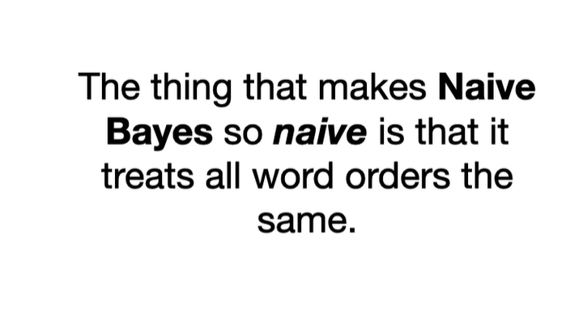
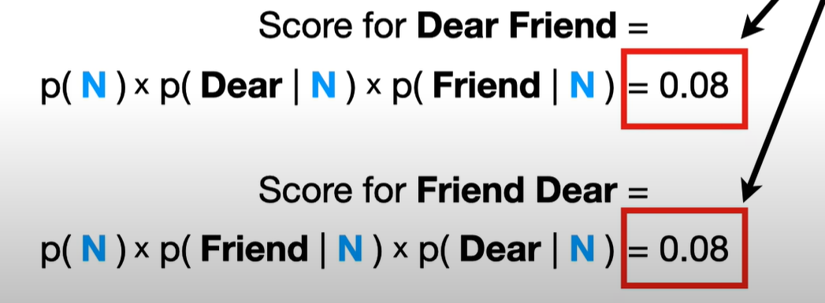
Naïve???
Assumes that the features of a data point are independent of each other.
Unrealistic but Still works like a magic

Slide 20
Demo

Slide 21
Ensemble Methods
Ensemble learning helps improve machine learning results by combining several models.
We can use these techniques for regression as well as classification problems.
The final prediction from these ensembling techniques is obtained by combining results from several base models.
Averaging, voting and stacking are some of the ways the results are combined to obtain a final prediction

Slide 22
Types of Ensemble Learning
Bagging
Boosting

Slide 23
Implementation Steps of Bagging
Step 1: Multiple subsets are made from the original information set with identical tuples, deciding on observations with replacement.
Step 2: A base model is created on all subsets.
Step 3: Every version is found in parallel with each training set and unbiased.
Step 4: The very last predictions are determined by combining the forecasts from all models.

Slide 24
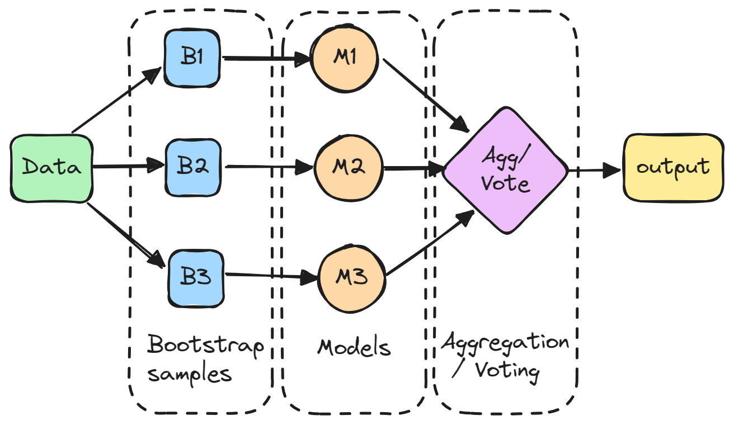
Bagging

Slide 25
Benefits of Bagging
Reduce Overfitting
Improve Accuracy
Handles Unstable Models

Slide 26
Cons
Increased Complexity and Computational Cost
Each model needs to be trained and stored, which can be computationally expensive

Slide 27
Boosting
Boosting is an ensemble modeling technique that attempts to build a strong classifier from the number of weak classifiers.
The main idea behind boosting is to iteratively train weak models on different subsets of the training data
It is done by building a model by using weak models in series.
models are designed to focus more on the examples that the previous models struggled to classify correctly

Slide 28
Implementation Steps of Boosting
1. Initialize weights
At the start of the process, each training example is given equal weight.
2. Train a weak learner
The weighted training data is used to train a weak learner.
3. Error calculation:
The error of the weak learner on the training data is computed.

Slide 29
Implementation Steps of Boosting
4. Update weights
Weights are updated according to the mistake rate of the training examples.
Misclassified examples are given higher weights, whereas correctly classified examples are given lower weights.
5. Repeat
Steps 2–4 are repeated several times. A new weak learner is trained on the updated weights of the training examples in each cycle.

Slide 30
Implementation Steps of Boosting
6. Combine weak learners
The final model is made up of all of the weak learners that were trained in the preceding steps.
The accuracy of each weak learner is weighted, and the final prediction is based on the weighted total of the weak learners.
7. Forecast
The finished model is used to forecast fresh instances’ class labels.

Slide 31
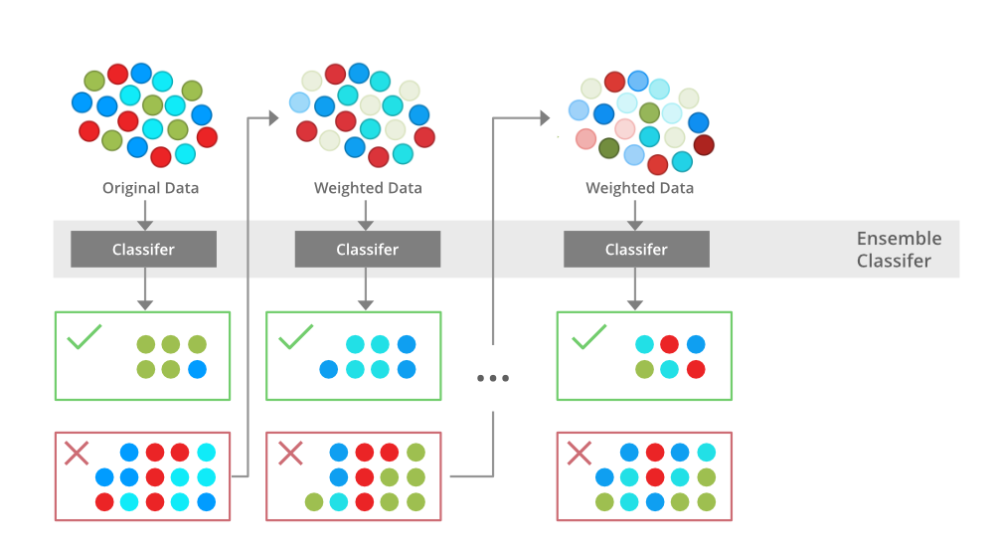
Boosting

Slide 32
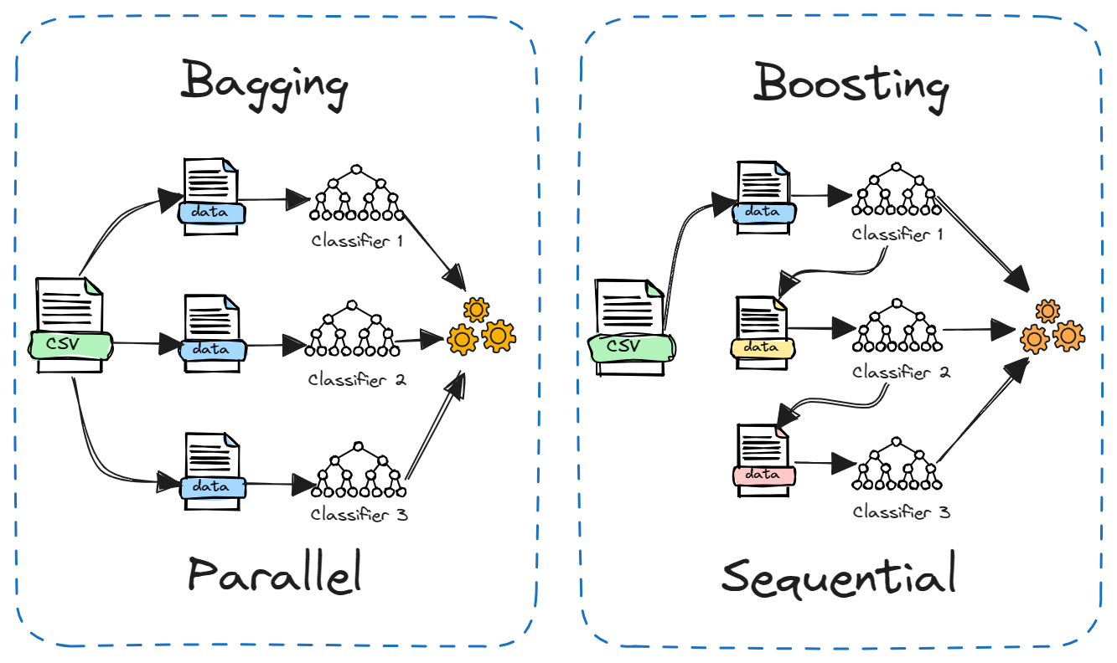
Differences Figuratively

Slide 33
Demo

Slide 34
Terminologies used in SVM
Support vector
The vector points closest to the hyperplane
SVMs are named after these support vectors
Hyperplane
In SVM, the hyperplane is the decision boundary in the feature space
The dimension of the hyperplane depends upon the number of features
If the number of input features is two, then the hyperplane is just a line
If the number of input features is three, then the hyperplane becomes a 2-D plane

Slide 35
Margin
it is the distance between the hyperplane and the observations closest to the hyperplane (support vectors)
In SVM large margin is considered a good margin
Hard Margin
If the training data is linearly separable,
we can select two parallel hyperplanes that separate the two classes of data
so that the distance between them is as large as possible

Slide 36
Soft Margin
As most of the real-world data are not fully linearly separable
we will allow some margin violation to occur
It is better to have a large margin, even though some constraints are violated
Margin violation means choosing a hyperplane, which can allow some data points to stay in either the incorrect side of the hyperplane

Slide 37
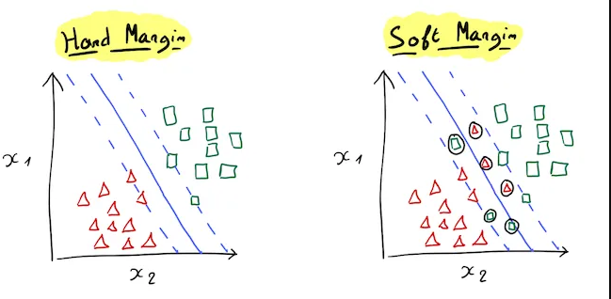

Slide 38

SVM working mechanisms

Slide 39
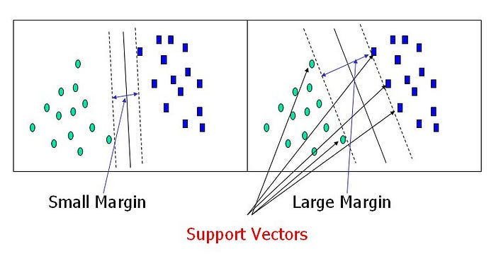

Slide 40
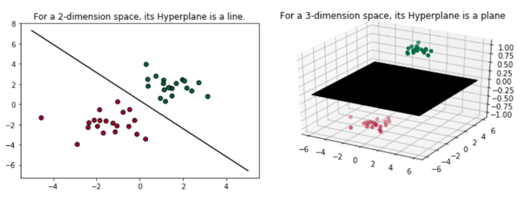
2D and 3D dimensional space

Slide 41
Types of Support Vector Machines
Linear SVM
use a linear decision boundary to separate the data points of different classes
a single straight line can entirely divide the data points into their respective classes
Non-Linear SVM
used to classify data when it cannot be separated into two classes by a straight line
using kernel functions, nonlinear SVMs can handle nonlinearly separable data (gaussian kernel, sigmoid & polynomial kernel)
A linear SVM is used to locate a nonlinear decision boundary in this modified space

Slide 42
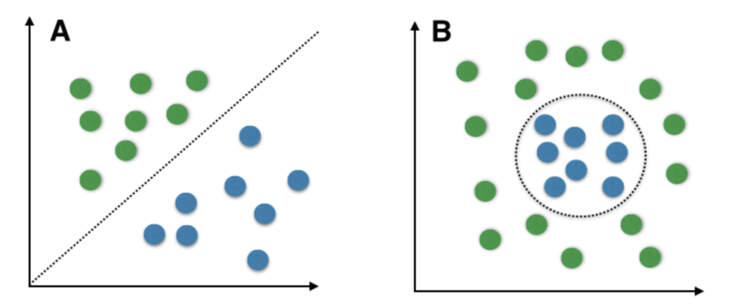
Figure

Slide 43
Pros and Cons of SVM
Pros
Accuracy
Works well on smaller cleaner datasets
More efficient on Higher dimensional spaces
Cons
Isn’t suited to larger datasets as the training time with SVMs can be high
Less effective on noisier datasets with overlapping classes

Slide 44
Applications of SVM in real life
Face Detection
Image Classification
Bio-informatics
Text and hypertext categorization
Handwriting Recognition

Slide 45
Demo

Slide 46
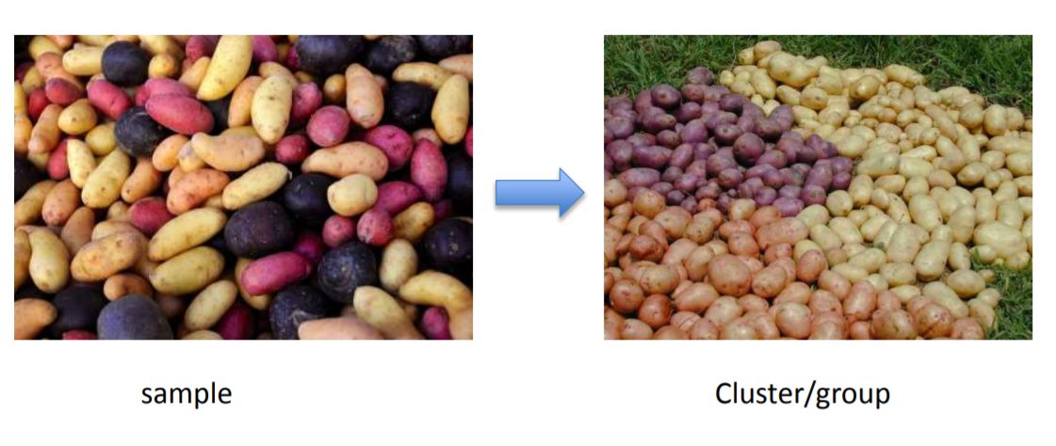
Clustering
Gathering samples into groups of similar samples according to some predefined similarity or dissimilarity measure.

Slide 47
Examples where clustering are used?
Market segmentation - group customers into different market segments.
Social network analysis - Facebook "smartlists"
Organizing computer clusters and data centers for network layout and location
Astronomical data analysis - Understanding galaxy formation

Slide 48
K means Clustering Algorithm
Given k, the k-means algorithm works as follows:
1. Choose k (random) data points (seeds) to be the initial centroids, cluster centers
2. Assign each data point to the closest centroid
3. Re-compute the centroids using the current cluster memberships
4. If a convergence criterion is not met, repeat steps 2 and 3

Slide 49
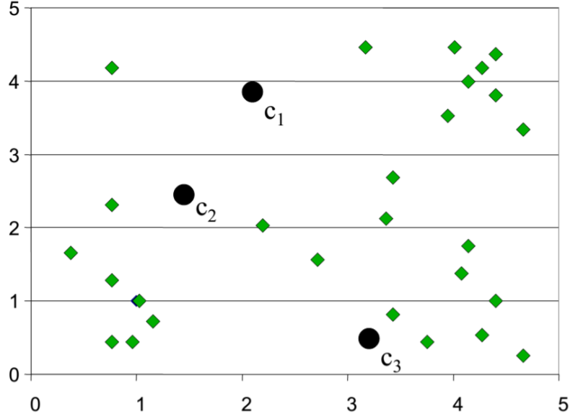
Random Initialization of Cluster Centers

Slide 50
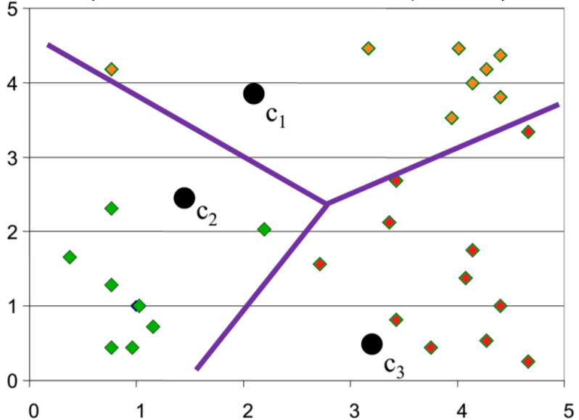
Determination of Cluster membership for each input

Slide 51
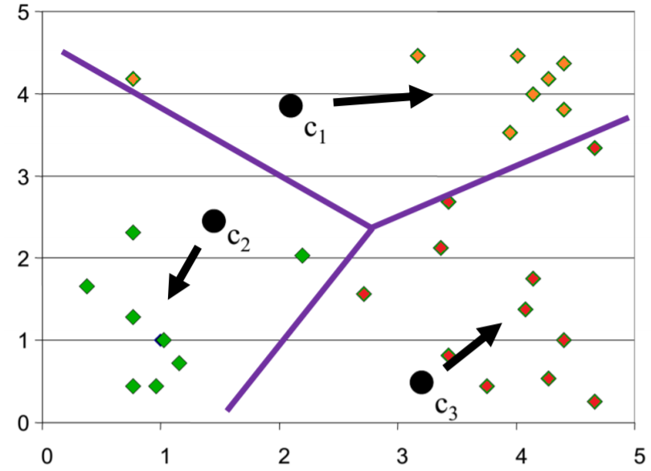
Re-estimation of Cluster Centers

Slide 52
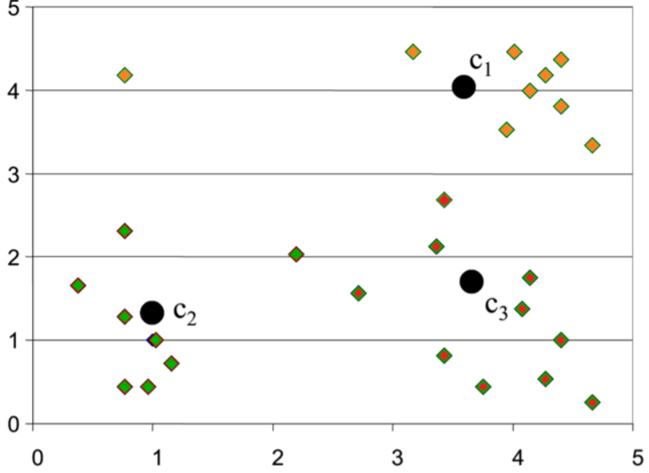
Result from first iteration

Slide 53
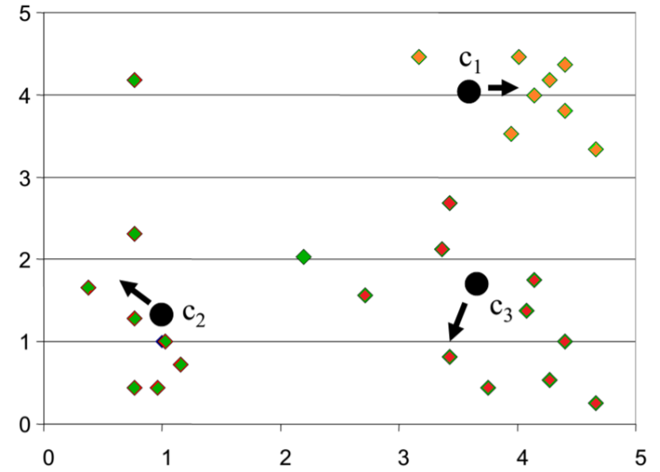
Result from second Iteration

Slide 54
Demo

Slide 55
Dimensionality Reduction
Dimensionality reduction refers to the process of reducing the number of random variables under consideration by obtaining a set of principal variables.
Importance: It simplifies models, reduces computational cost, and helps in visualizing data.

Slide 56
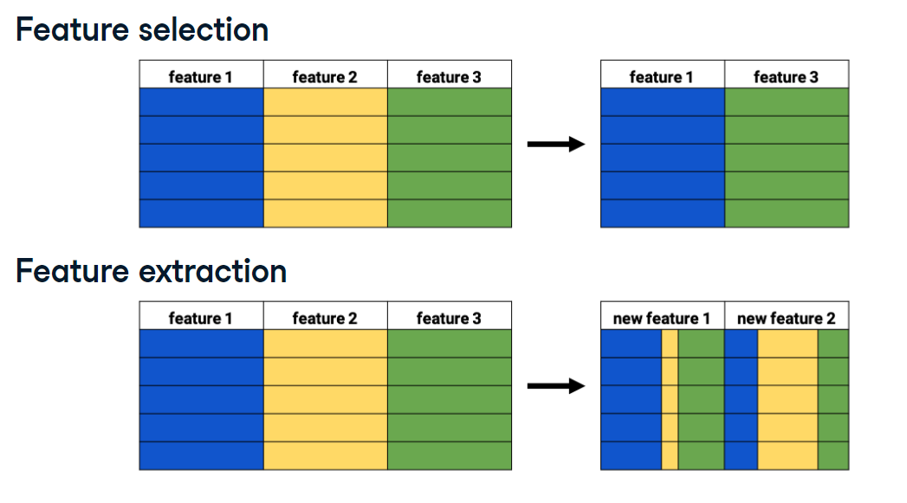
Dimensionality Reduction
Filter methods, Wrapper methods, Embedded methods.
Principal Component Analysis (PCA), Linear Discriminant Analysis (LDA), t-Distributed Stochastic Neighbor Embedding (t-SNE), and Autoencoders.

Slide 57
Principal Component Analysis (PCA)
PCA is a statistical procedure that uses an orthogonal transformation to convert a set of possibly correlated variables into a set of values of linearly uncorrelated variables called principal components.
PCA transforms data into a new coordinate system where the greatest variance comes to lie on the first coordinates (principal components).
To reduce the dimensionality of the data while retaining as much variance as possible.

Slide 58
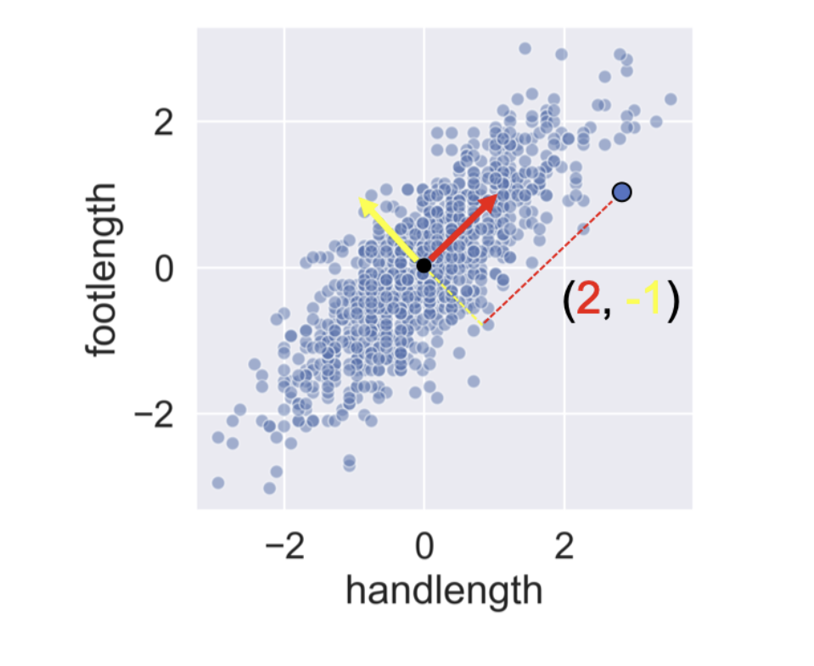

Slide 59
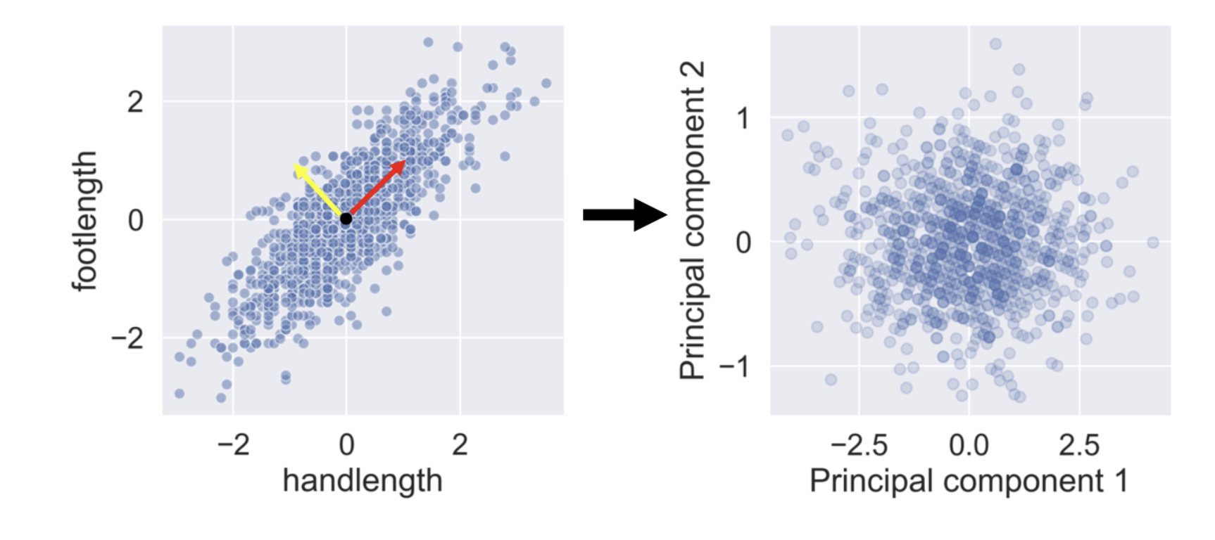

Slide 60
t-Distributed Stochastic Neighbor Embedding (t-SNE)
t-SNE is a non-linear dimensionality reduction technique that is particularly well suited for embedding high-dimensional data into a space of two or three dimensions for visualization.
To preserve the local structure of the data in the low-dimensional space.

